Slide 1


Slide 2
Agenda
About The Company
Problem Statement
Objective
Datasets
Insights
Recommendations
Conclusion

Slide 3
AtliQ Grands
AtliQ Grands is a premier luxury hospitality brand that owns and operates a chain of five-star hotels across major cities in India.
With a strong legacy spanning over 20 years, AtliQ Grands has established itself as a trusted name in the hospitality industry, known for its world-class service, elegant design, and exceptional guest experiences.
The company’s portfolio includes flagship properties in key metropolitan and tourist destinations, catering to both business and leisure travelers.
Driven by a commitment to excellence and innovation, AtliQ Grands continues to set new benchmarks in luxury and customer satisfaction across the Indian hospitality landscape.

Slide 4
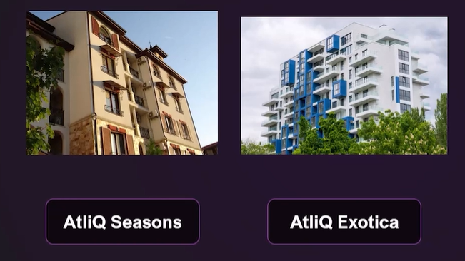
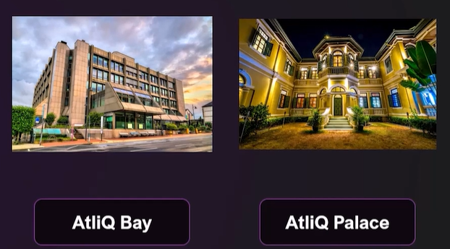
AtliQ Hotels

Slide 5
Problem Statement
AtliQ Grands is a company with 20 years of experience in Hotel Industry. It was losing its market share and revenue due to strategic moves from other competitors and ineffective decision-making in management.
The company wants to incorporate Business Intelligence and Data Analytics to regain its market share and revenue.

Slide 6
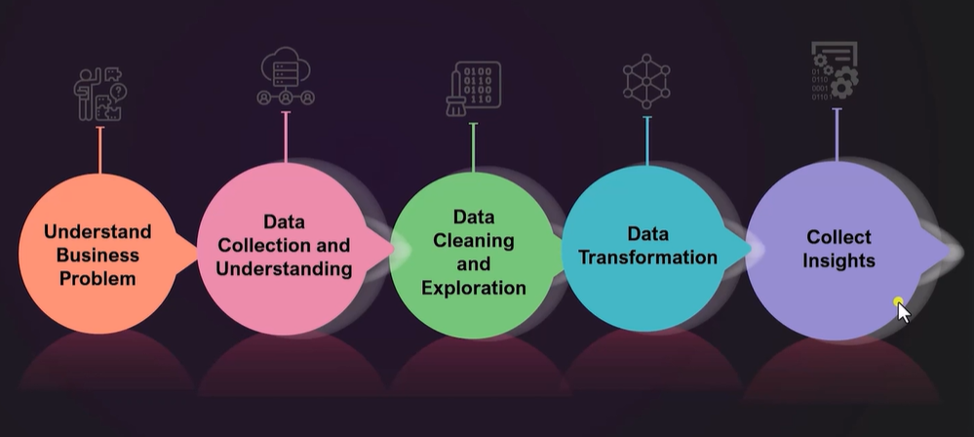
Objective
Create a python project for analysis.
Create a presentation detailing the insights and recommendations.
Present the insights before the client.

Slide 7
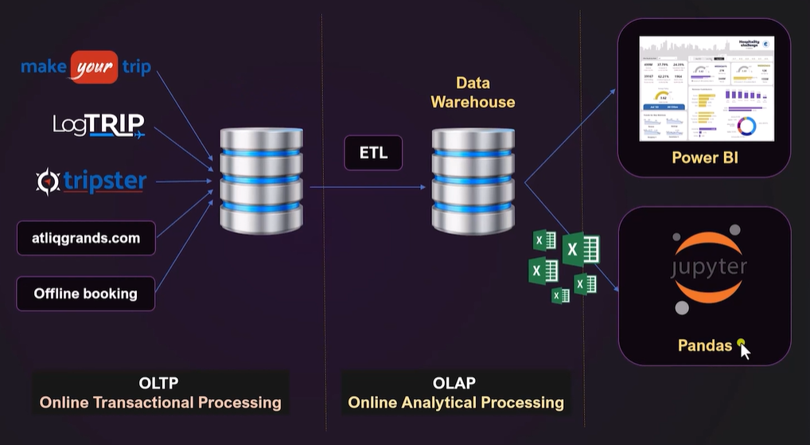
Data Pipeline

Slide 8
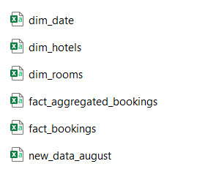
Datasets

Slide 9
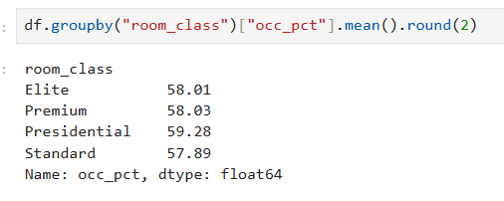
Insights:
What is the Average Occupancy rate in each room class ?
Underperforming Room Class: Standard
High Performing Room Class: Elite

Slide 10
Recommendations:
As per May 2022-July 2022 data. ➡️ Conduct a competitive analysis to adjust pricing for Standard rooms.
➡️ Bundle Standard rooms with additional amenities or discounts to boost occupancy.
➡️ Offer targeted marketing for Standard rooms, highlighting value-for-money benefits.

Slide 11
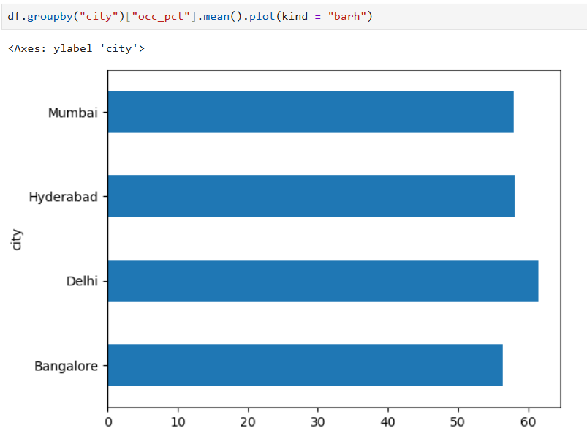
Insights:
What is the Average Occupancy rate per City ?
Underperforming City: Bangalore
High Performing City: Delhi

Slide 12
Recommendations:
As per May 2022-July 2022 data. ➡️ Conduct a market analysis to understand demand patterns and pricing elasticity in Bangalore.
➡️ Implement dynamic pricing to attract more bookings during low-occupancy periods.
➡️ Introduce localized marketing campaigns (e.g., weekend getaways or staycations) to stimulate demand.

Slide 13
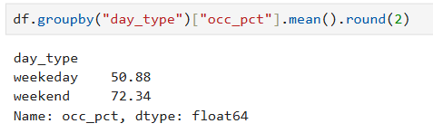
Insights:
When was the Occupancy better?
Highest Occupancy: Weekday

Slide 14
Recommendations:
As per May 2022-July 2022 data. ➡️ Implement weekday-specific promotions to increase weekday bookings (e.g., business travel packages or work-from-hotel offers).
➡️ Collaborate with nearby businesses or corporate offices for corporate tie-ups and long-stay offers.
➡️ Focus on promoting weekend packages to maintain strong weekend occupancy.

Slide 15
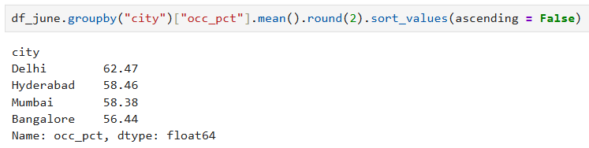
Insights:
What is the occupancy for different cities in the month of June?
Highest Occupancy: Delhi
Lowest Occupancy: Bangalore

Slide 16
Recommendations:
As per May 2022-July 2022 data. ➡️ Analyze historical data to identify any recurring patterns or seasonality impacting Bangalore.
➡️ Develop targeted marketing for the upcoming months to address the June dip.
➡️ Offer limited-time promotions or special packages to boost occupancy.

Slide 17
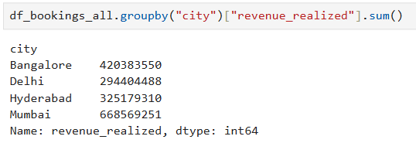
Insights:
What is the revenue realized per city ?
Highest Revenue: Mumbai
Lowest Revenue: Delhi

Slide 18
Recommendations:
As per May 2022-July 2022 data. ➡️ Maintain premium pricing for targeted segments but introduce lower-priced packages to increase occupancy.
➡️ Explore targeting different customer segments (e.g., budget travelers, business travelers, etc.).
➡️ Analyze average length of stay and adjust marketing for longer stays.

Slide 19
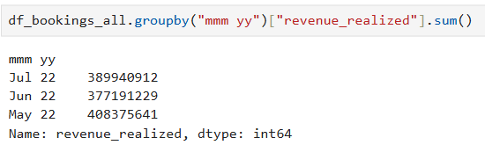
Insights:
What is the month by month revenue?
Highest In: May
Lowest In: June

Slide 20
Recommendations:
As per May 2022-July 2022 data. ➡️ Analyze potential reasons for the June dip (e.g., holidays, events, weather, etc.).
➡️ Implement early-bird or last-minute deals in the month of June to boost occupancy and revenue.
➡️ May often marks the end of the fiscal year for many companies, leading to increased business travel.
➡️ Create attractive weekday corporate packages to leverage this trend and balance occupancy.

Slide 21
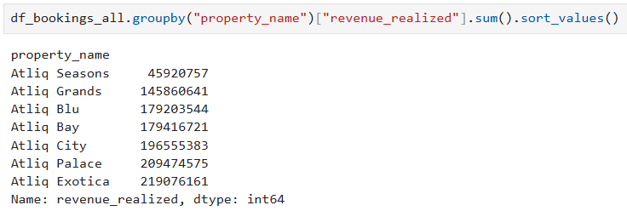
Insights:
Revenue Realized per Hotel Type ?
Highest Revenue:
AtliQ Exotica
Lowest Revenue:
AtliQ Seasons

Slide 22
Recommendations:
As per May 2022-July 2022 data. ➡️ Assess service quality, facilities, and pricing at AtliQ Seasons to identify improvement areas.
➡️ Introduce promotional campaigns or rebranding initiatives to attract more guests.
➡️ Consider cross-promotional strategies with other AtliQ properties.

Slide 23
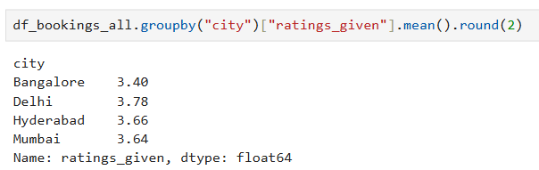
Insights:
Average Rating per City ?
Highest Rating:
Delhi
Lowest Rating:
Mumbai

Slide 24
Recommendations:
As per May 2022-July 2022 data. ➡️ Conduct a root cause analysis of customer complaints in Bangalore.
➡️ Implement a guest feedback mechanism to promptly address issues and enhance service quality.
➡️ Launch a reputation management campaign to improve ratings and attract more bookings.

Slide 25
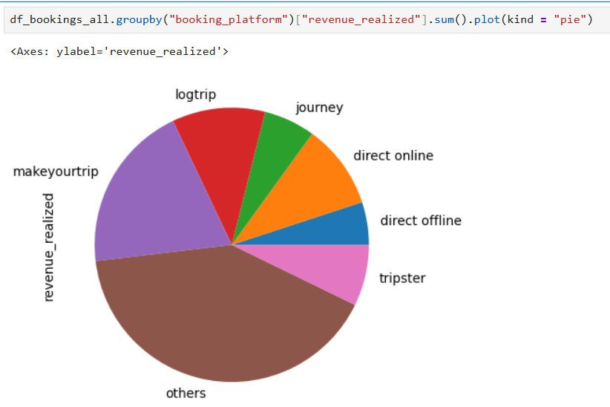
Insights:
Revenue Realized per Booking Platform ?
Highest Revenue:
makeyourtrip
Lowest Revenue:
direct offline

Slide 26
Recommendations:
As per May 2022-July 2022 data. ➡️ Optimize listings on major booking platforms (e.g., MakeYourTrip, Tripster) to increase visibility and attract more bookings.
➡️ Negotiate better commission rates with high-performing platforms.
➡️ Implement platform-specific promotional offers to boost direct bookings.

Slide 27


Thank you
For feedback and suggestions feel free to connect me
with me on:
LinkedIn
Github
Or email me directly at:
ayushrekh12065@gmail.com

